Slide 1

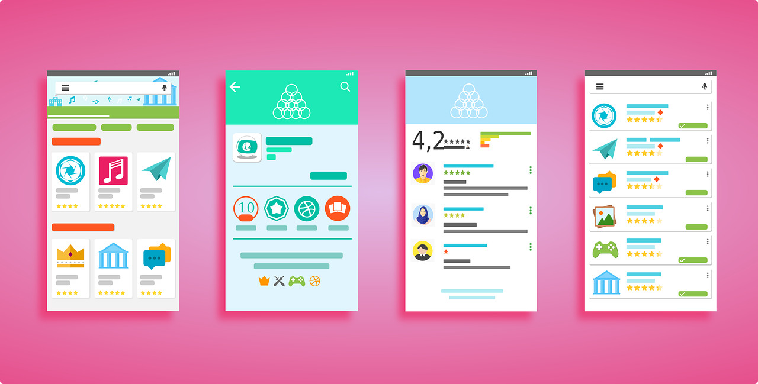
Android: User Interface
LEIM – DAM

Slide 2
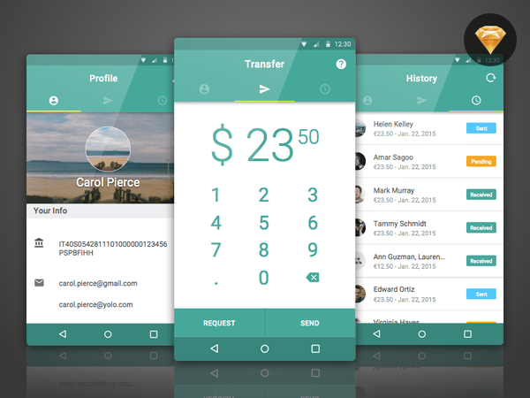
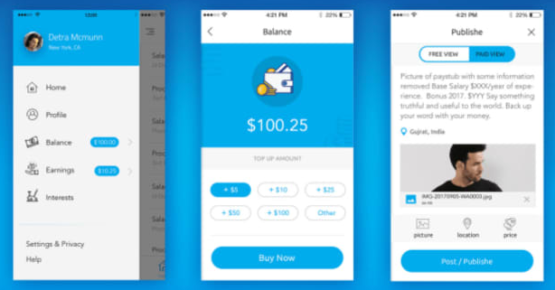
User Interface (UI)
App's user interface is what the user see and interact with
Android have many UI components
Layout, widgets
Android have UI modules for special interfaces
dialogs, notifications, menus, …

Slide 3
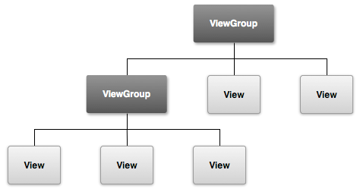
User Interface (UI)
UI elements are based on:
View Class – is/describes one UI visual element
Base class for "widgets“. Ex: TextView, ImageView, Button, RatioButton, …
Usually draws something the user can see and interact with
ViewGroup class – an element to contain other elements
May contain Views and ViewGroups
Base class for "layouts“
Ex: ConstraintLayout, LinearLayout, FrameLayout, GridLayout, …
It is a View sub-class
Should be the root element in a Layout file

Slide 4
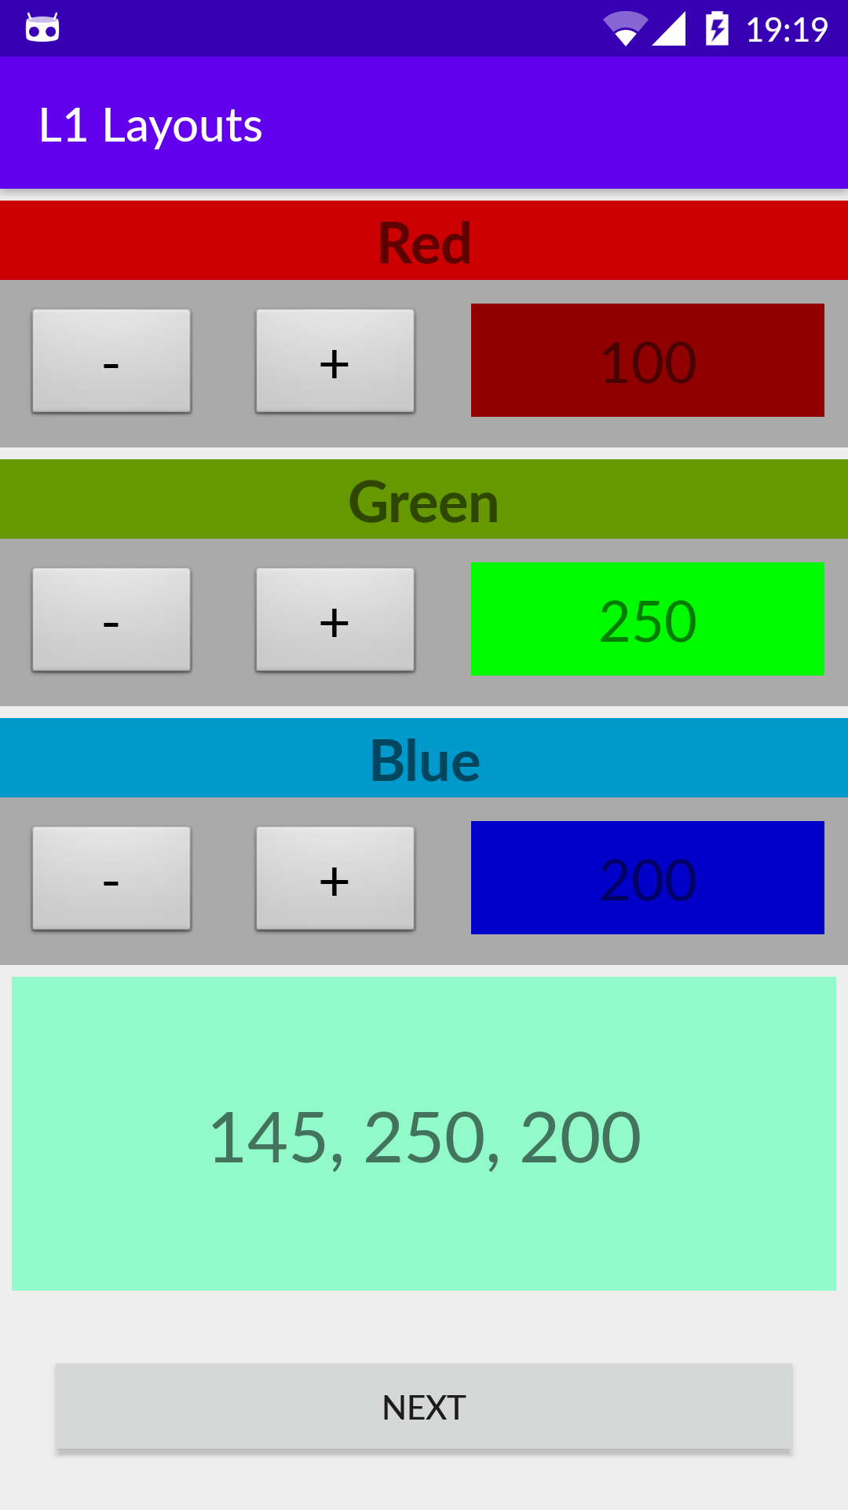
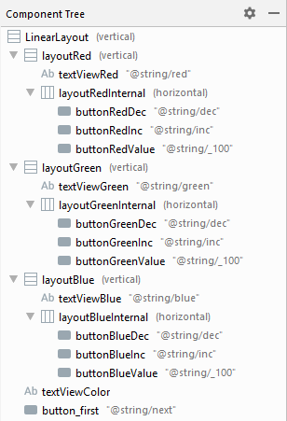
UI: ViewGroups and Views
Layout
…
Widgets
…
L1 Layouts app

Slide 5
User interface statically defined in XML
The user interface can be declared in XML files
These files are called layout files (but they just contain elements)
These file describe the UI elements that will be shown
They should contain one element, usually a ViewGroup
These root elements usually contain other elements
Forming a tree of elements, called the View Hierarchy
activity_main.xml is the usual name for the first activity layout file
Layout in activities
To set a layout file in the current activity, use: Activity.setContentView in onCreate
The rendering starts from the root node and goes all the way down the tree
If Views overlap, the last one to be rendered in the one visible
public void onCreate(Bundle savedInstanceState) { super.onCreate(savedInstanceState); setContentView(R.layout.activity_main);
}

Slide 6
Layout: activity_main.xml
<?xml version="1.0" encoding="utf-8"?>
<LinearLayout xmlns:android="http://schemas.android.com/apk/res/android" android:layout_width="match_parent" android:layout_height="match_parent" android:orientation="vertical" > <LinearLayout android:id="@+id/layoutRed" android:layout_width="match_parent" android:layout_height="wrap_content" android:layout_marginTop="5dp" android:background="@android:color/darker_gray" android:orientation="vertical"> <TextView android:id="@+id/textViewRed" android:layout_width="match_parent" android:layout_height="wrap_content" android:background="@android:color/holo_red_dark" android:text="@string/red" android:textAlignment="center" android:textSize="24sp" android:textStyle="bold" /> ...
Each XML element type have an Java class with the same name and that for each element it is instantiated one instance of that class:
<TexView> -> TextView
<RelativeLayout> -> RelativeLayout
When Android loads a layout (in XML) it creates and initialize the objects described in the XML elements and with the properties defined
Initial content of activity_main.xml of L1 Layouts app

Slide 7
Resource attributes
Vou AQUI
View or ViewGroup attributes
Specific attributes
textSize - <TextView>
Inherited
From the View root (e.g., ID attribute)
LayoutParams
Attributes that describe the orientation of the View object in the layout

Slide 8
Resource ID attribute
ID attribute associated with each View object to uniquely identify it
When the application is compiled
string XML is converted in an integer
Sintaxe:
android:id="@+id/elemIdentifier"
The @ symbol indicates that the XML parser must expand the rest of the string ID and identify it as an asset ID.
The + symbol means that we have a new element that must be added to the resources (R.java)

Slide 9
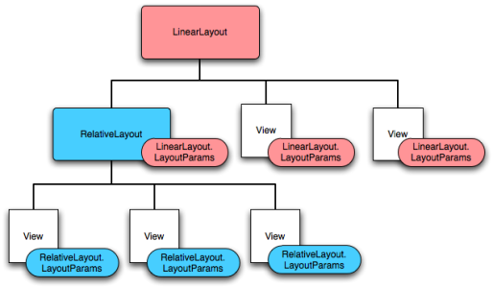
Layout Parameters
Hierarchy View with parameters associated with each View

Slide 10





View: Attributes of Positioning
getTop()
getBottom()
getLeft()
View
getRight()
Parent

Slide 11
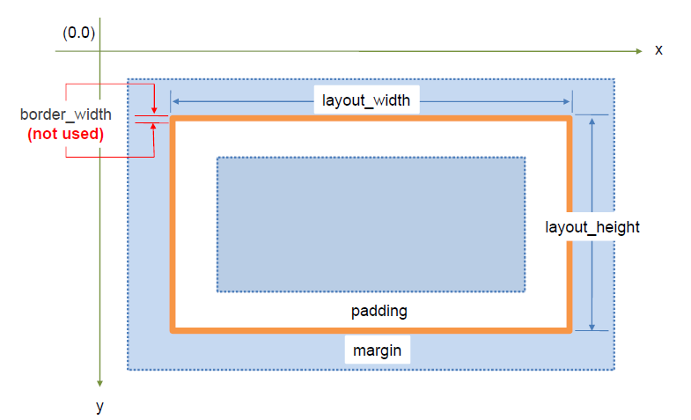
Attributes: Dimensions, Padding and Margins

Slide 12
Attributes: most used ones
Atributos | Descrição
android:layout_width | layout width
android:layout_height | layout height
android:layout_marginTop | Extra space at the top of the layout
android:layout_marginBottom | Extra space at the bottom of the layout
android:layout_marginLeft | Extra space on the left side of the layout
android:layout_marginRight | Extra space on the right side of the layout
android:layout_gravity | Defines how child Views are positioned
android:layout_weight | Sets when extra space is allocated to View
android:layout_x | Sets the x coordinate of the layout
android:layout_y | Sets the y coordinate of the layout
android:paddingLeft | Padding on the left side of the layout
android:paddingRight | Padding on the right side of the layout
android:paddingTop | Padding on the top of the layout
android:paddingBottom | Padding at the bottom of the layout

Slide 13
android:layout_width and android:layout_height
“width” and “height”
Units in "dp" (density-independent pixels)
wrap_content
The dimensions of the View are set to the values needed for presenter content
match_parent
The dimensions of the View increase to the dimensions that the parent ViewGroup allows

Slide 14
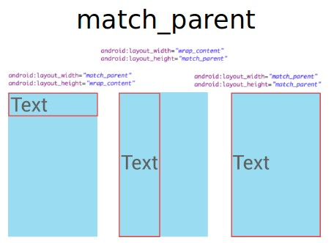
match_parent and wrap_content

Slide 15
Most used Layouts
Layout (ViewGroups) | Description
ConstraintLayout | Allows to create large and complex layouts with a flat view hierarchy (no nested view groups).
LinearLayout | Displays child elements in a single horizontal or vertical line. Creates a scrollbar if the window length exceeds the screen length
TableLayout | Group Views in rows and columns
FrameLayout | Allows to lock an area of the screen to show a single element
ListView | Displays a vertically-scrollable collection of views (legacy)
GridView | Shows a grid of elements with "m" columns and "n" rows (legacy)

Slide 16
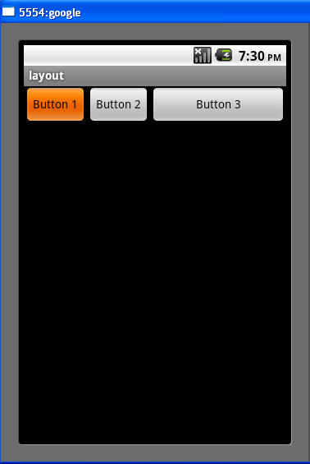
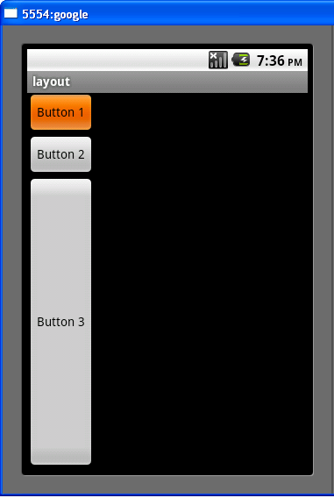
LinearLayout: horizontal/Vertical
<?xml version="1.0" encoding=“utf-8"?>
<LinearLayout
xmlns:android="http://schemas.android.com/apk/res/android"
android:layout_width="fill_parent"
android:layout_height="fill_parent"
android:orientation="horizontal" >
<Button android:id="@+id/button1" android:layout_width="wrap_content" android:layout_height="wrap_content" android:text="Button 1" />
<Button android:id="@+id/button2" android:layout_width="wrap_content" android:layout_height="wrap_content" android:text="Button 2" />
<Button android:id="@+id/button3" android:layout_width="wrap_content" android:layout_height="wrap_content" android:text="Button 3" android:layout_weight="1"/>
</LinearLayout>
Layout_weight – element importance in occupied space (default value 0)

Slide 17
ConstraintLayout
To create complex layouts with a flat view hierarchy
no nested ViewGroups – at their top level
all views are laid out according to relationships between sibling and parent views
Similar to RelativeLayout but more flexible and easier to use with Android Studio's Layout Editor
https://developer.android.com/training/constraint-layout

Slide 18
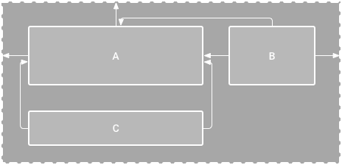
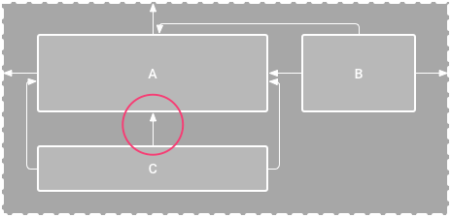
ConstraintLayout: Example
On left figure no vertical constraint on view C
On a device, view C horizontally aligns with the left and right edges of view A
However, it appears at the top of the screen because it has no vertical constraint

Slide 19
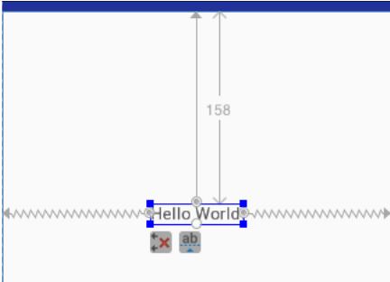
ConstraintLayout: Rules
Every View must have at least two constraints: one horizontal and one vertical
Constraints can only be created between a constraint handle and an anchor point that share the same plane
Constraint handle can be used for just one constraint, but you can create multiple constraints to the same anchor point

Slide 20
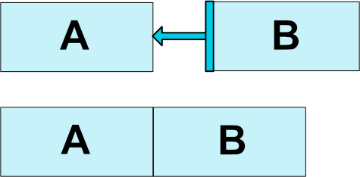

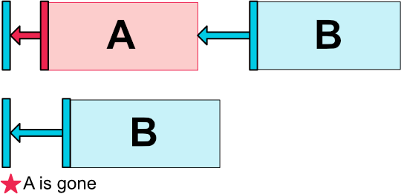
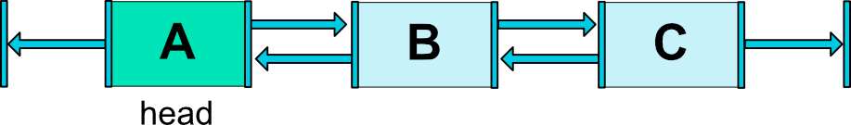
ConstraintLayout: Types of Constraints
Relative Positioning
Margins
Centering Positioning
Visibility Behavior
Dimension Constraints
Chains
Virtual Helpers Objects (Guideline and Barrier)

Slide 21
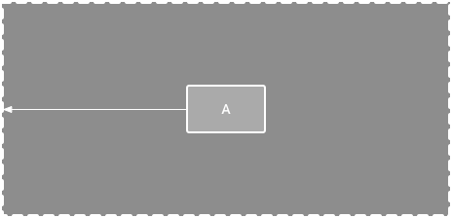
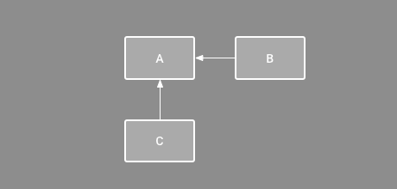
ConstraintLayout: Parent Position and Order Position
Horizontal constraint to the parent
Horizontal and vertical constraint

Slide 22
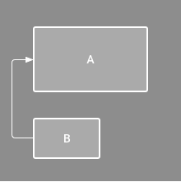
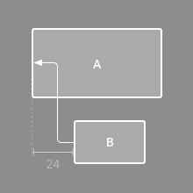

ConstraintLayout: Alignment
Horizontal alignment constraint
An offset Horizontal alignment constraint
Click on the align icon in the toolbar

Slide 23
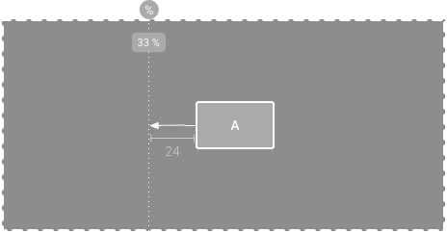
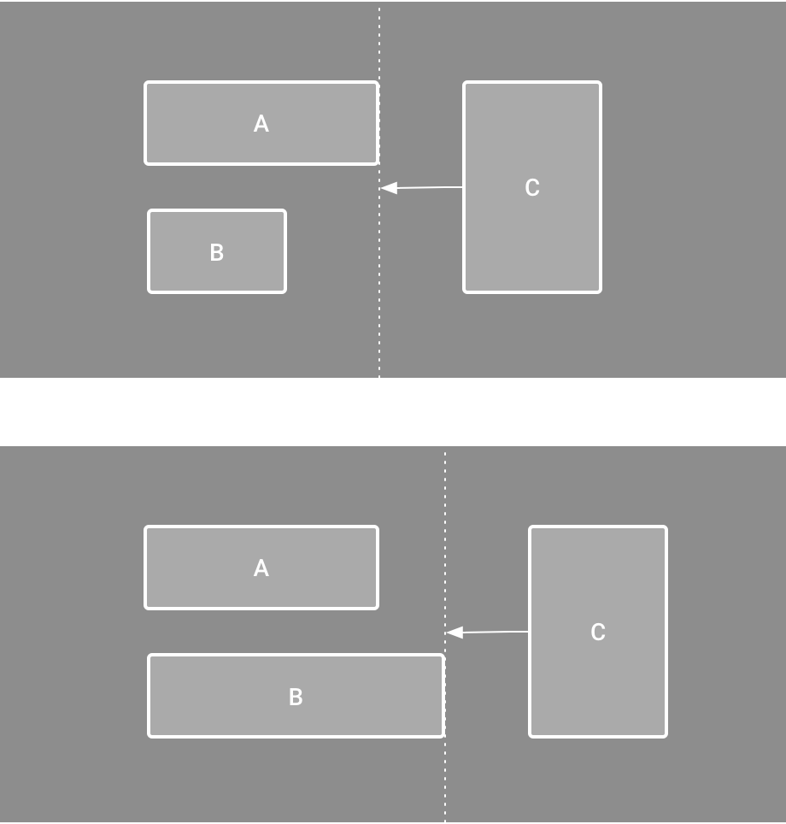

ConstraintLayout: Guideline and Barrier
View A is constrained to a
guideline
View C is constrained to a barrier, which moves based on the position/size of both view A and view B
Click on the Guidelines icon in the toolbar

Slide 24
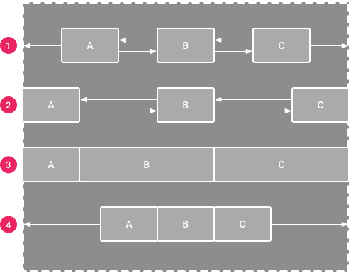

ConstraintLayout: Chains
- Spread
- Spread inside
- Weighted *
- Packed
Click on the Chain button to change the style of the chain
* Views with match constraints option and using the layout_constraintHorizontal_weight property

Slide 25
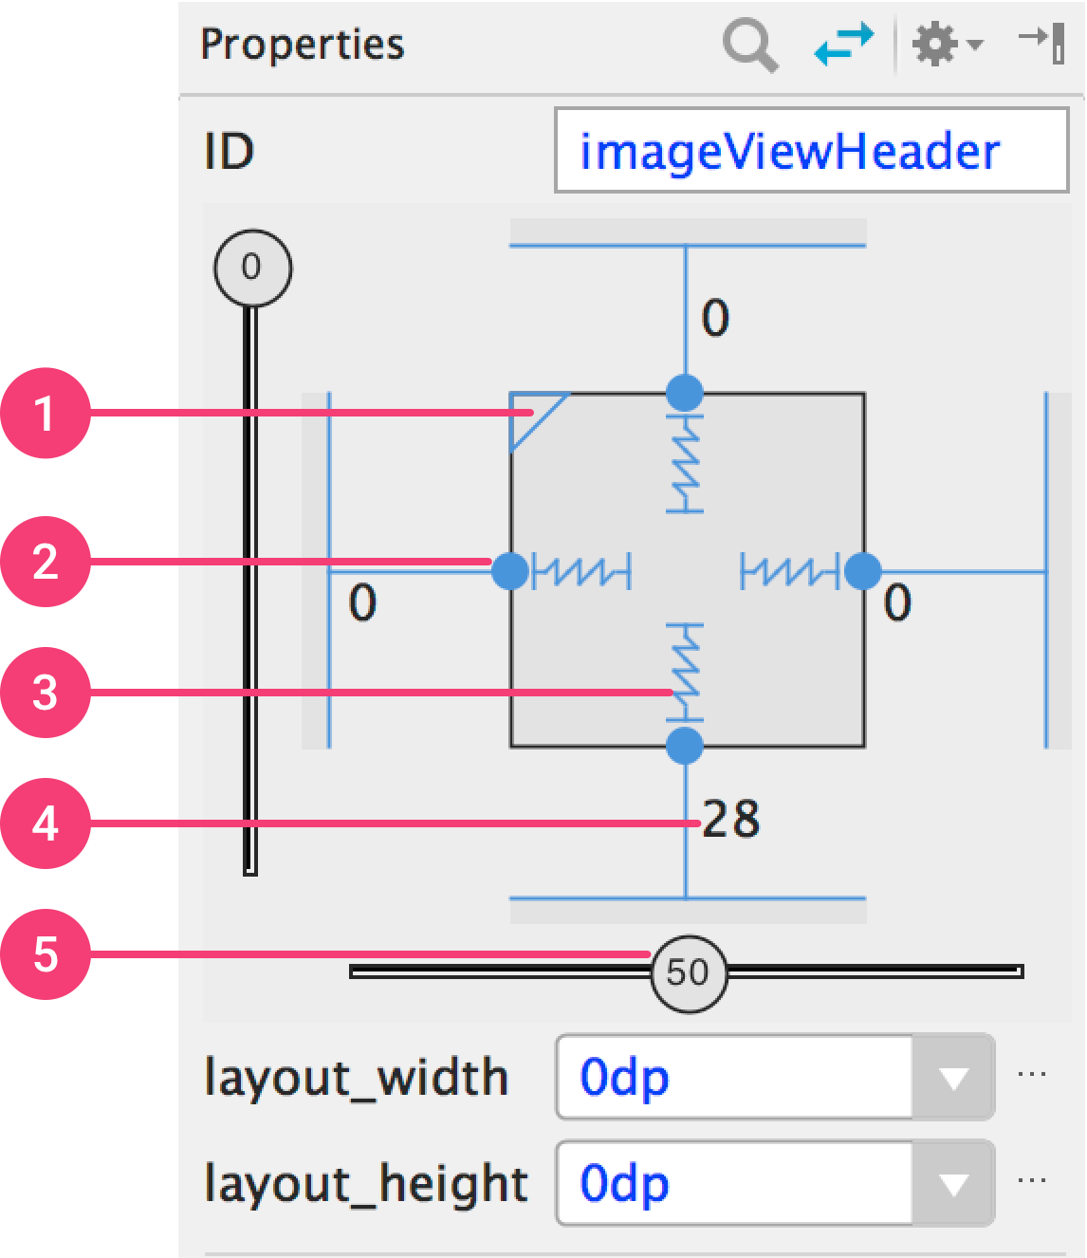



ConstraintLayout: View Size
wrap_content
match_constraints
fixed
Do no use match_parent with ConstraintLayout.
Use match_contraints instead.
1 - size ratio, 2 - delete constraint, 3 - height/width mode, 4 - margins, 5 - constraint bias

Slide 26
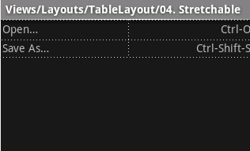
TableLayout
<?xml version="1.0" encoding=“utf-8"?>
<TableLayout
xmlns:android="http://schemas.android.com/apk/res/android" android:layout_width="match_parent"
android:layout_height="match_parent"
android:stretchColumns="1">
<TableRow>
<TextView
android:text="@string/table_layout_4_open" android:padding="3dip" />
<TextView
android:text="@string/table_layout_4_open_shortcut" android:gravity="right"
android:padding="3dip" />
</TableRow>
<TableRow>
<TextView
android:text="@string/table_layout_4_save" android:padding="3dip" />
<TextView
android:text="@string/table_layout_4_save_shortcut" android:gravity="right"
android:padding="3dip" />
</TableRow>
</TableLayout>

Slide 27
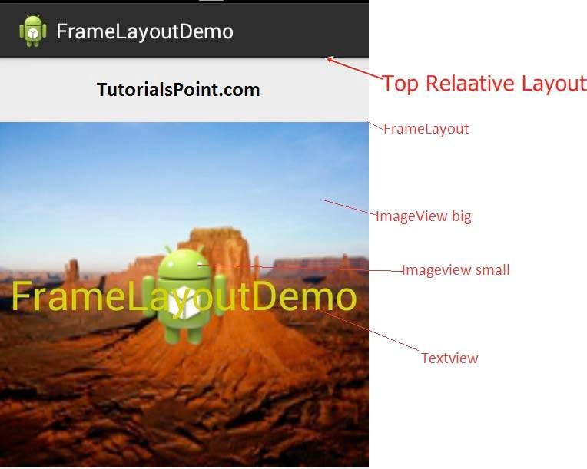
FrameLayout
FrameLayout is designed to block out an area on the screen to display a single item
In general, it should only contain a View because it is difficult to organize them so that they can be scalable to any screen without overlapping
To have more than one View one must use the attribute "gravity" in each View "child" (android:layout_gravity)

Slide 28
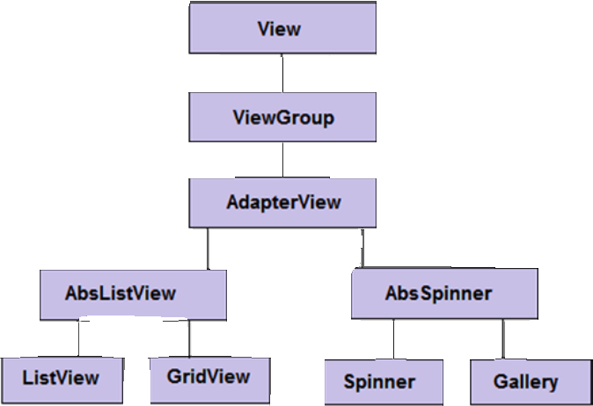






ListView and GridView
Dynamic Content
AdapterView subclass to put values in Layout
Class Adapter to fetch the data (e.g., from a database) and convert them into Views that are added to the AdapterView
ListView
GridView

Slide 29








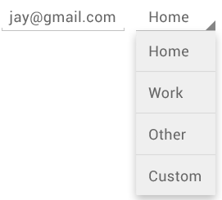
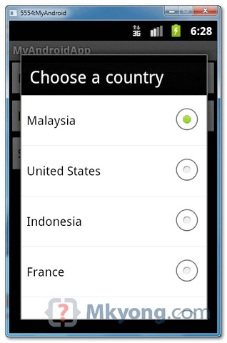
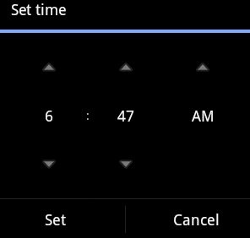

Widgets: Android UI Controls
TextView
EditText
Button
Checkbox
RadioButton
ToggleButton / Switch
Spinner
ProgressBar
TimePicker

Slide 30
UI Controls
UI Controls | Description
TextView | Used to show text to user
EditText | Pre-defined TextView sub-class which includes the possibility of editing the text
AutoCompleteTextView | Similar to EditText but shows a list with suggestions to help complete the text
Button / ImageButton | Button that can be pressed by the user / Button with an Image
CheckBox | To select options that are not mutually exclusive
RadioButton / RadioGroup | To select options that are mutually exclusive. To have that, they must be registered in RadioGroup
ToggleButton / Switch | A button that has two states (ex: on / off)
Spinner | Provides a way to select one value from a list or a set
ProgressBar | Provides visual feedback about a task that is being performed
Picker | TimePicker or DatePicker. Allows users to choose a time of day or a date

Slide 31
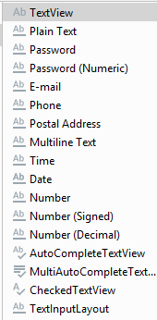
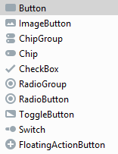
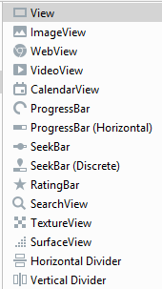
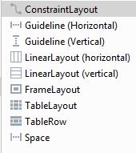
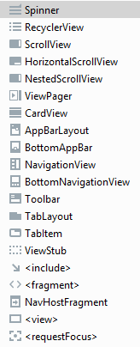
Android Studio Pallete groups
Text
Buttons
Widgets
Layouts
Containers

Slide 32
UI with dynamic changes in code
Building UI Elements
Declared in XML
Created in code
In code we can create any element and set any attribute to them
public void onCreate(Bundle savedInstanceState) { super.onCreate(savedInstanceState);
setContentView(R.layout.activity_main);
}
public void onCreate(Bundle savedInstanceState) { super.onCreate(savedInstanceState);
ConstraintLayout constrLayout = new ConstraintLayout(this); TextView tv = new TextView(this); tv.setText("Test"); constrLayout.addView(tv); setContentView(constrLayout, ...);
}

Slide 33
Icons & Images

Slide 34
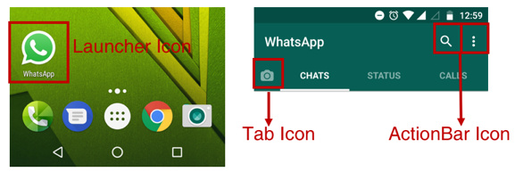
Icons
Icon categories:
Launcher Icon
Adaptive Launcher Icon, for Android 8.0 (API level 26) or above
Legacy Launcher Icon, for Android 7.1 (API level 25) or below.
Action Bar Icons: for the items in the action bar
Tab Icons: for the tab items that have icons, if any
https://code.tutsplus.com/tutorials/how-to-update-the-launcher-icon-for-your-android-app--cms-30624

Slide 35
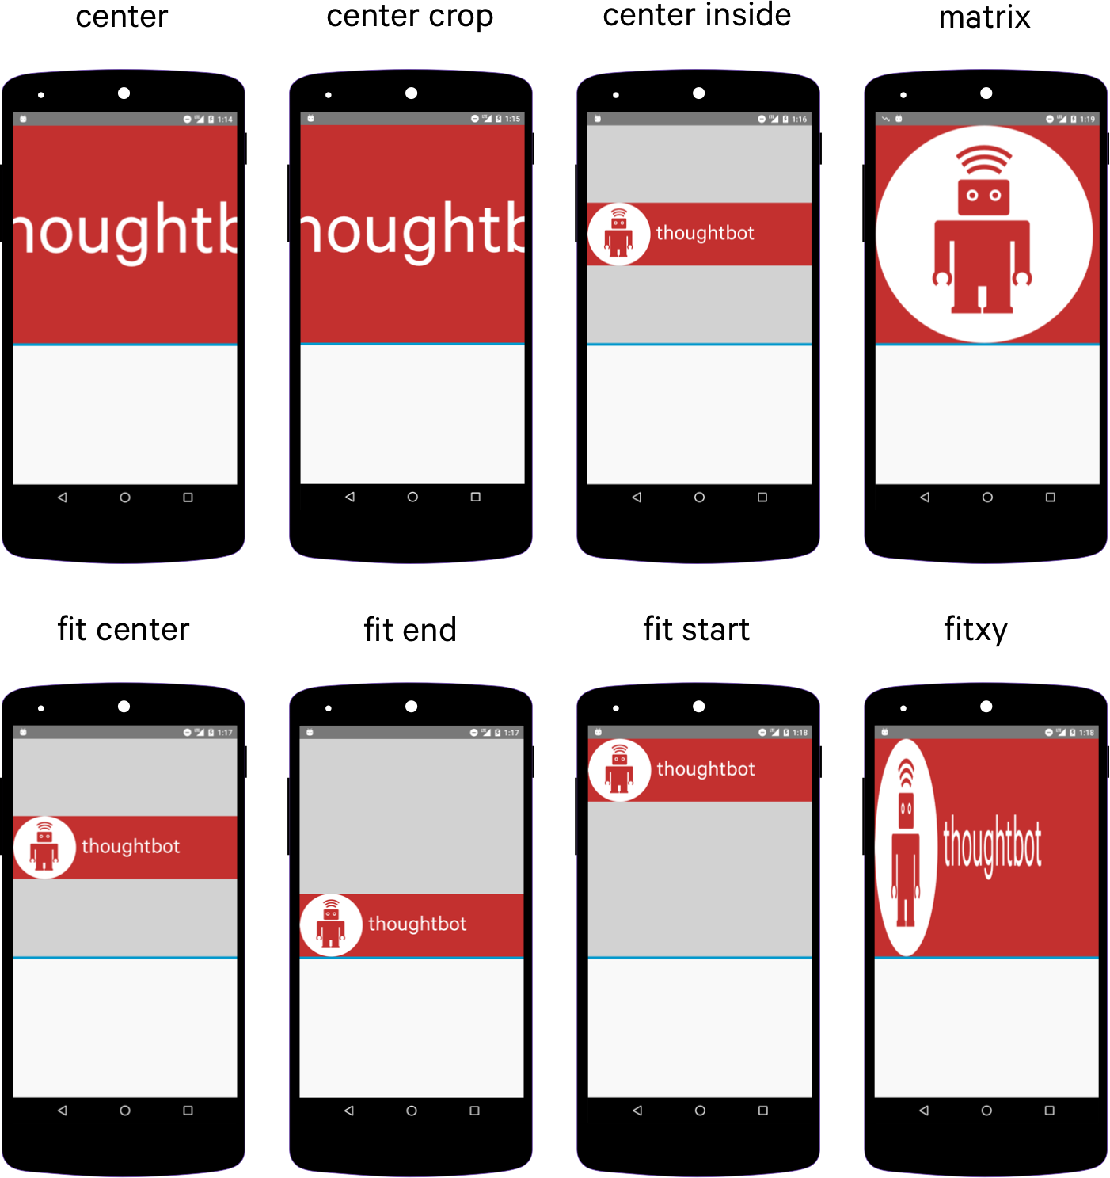
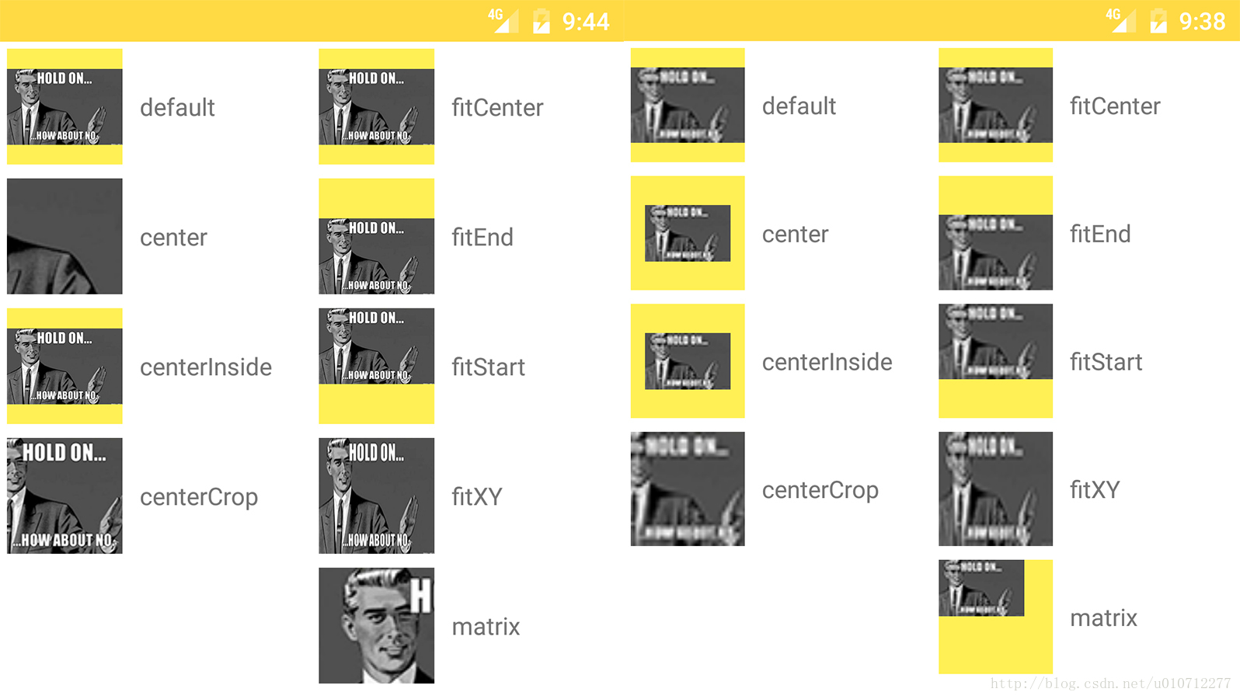
Images: ScaleType
https://blog.csdn.net/u010712277/article/details/74079620
https://thoughtbot.com/blog/android-imageview-scaletype-a-visual-guide

Slide 36
Bibliography
Layouts
Input Controls
Layout Resources (attributes)
ConstraintLayout
Performance and View Hierarchies

